Slide 1
ART4320 Photography II Color Analysis Project Student Name: Student 1
Due date: 01.31.2023
Students need to submit their 3 photos, 3 pie charts, and 3 color wheels.
Please delete instructor’s examples before submissions.
1 Monochromatic photo, 1 pie chart, 1 color wheel
1 Analogous photo, 1 pie chart, 1 color wheel
1 complimentary photo, 1 pie chart, 1 color wheel

Slide 2
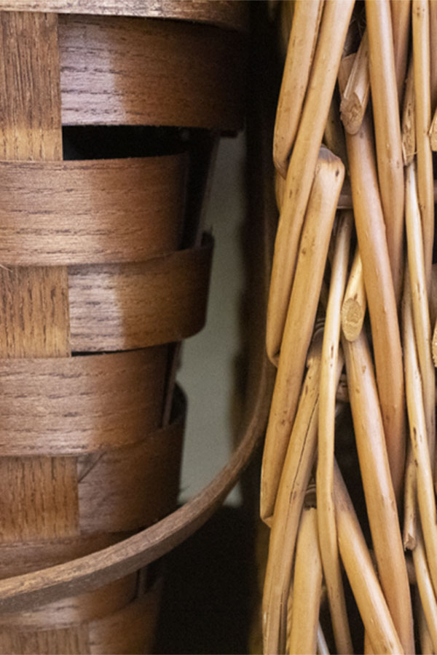
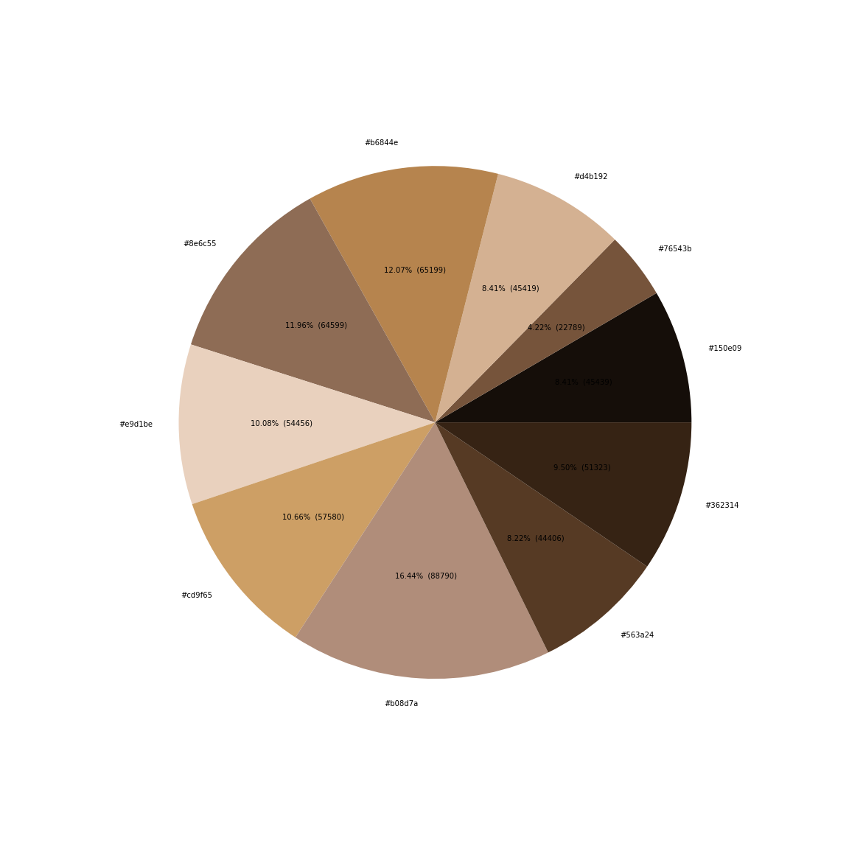
1. Monochromatic
Explain color harmony with color combination: Monochromatic color scheme with brown.
Write 5 hex colors with percentages: #b6844e(12.07%)#b08d7a(16.44%) #cd9f65(10.66%) #e9d1be(10.80%) #8e6c55(11.96%)
Which color is the most used? #b08d7a(16.44%)
What is the brightest color? #e9d1be(10.80%)
What is the darkest color? #150e09(8.41%)
Caption

Slide 3
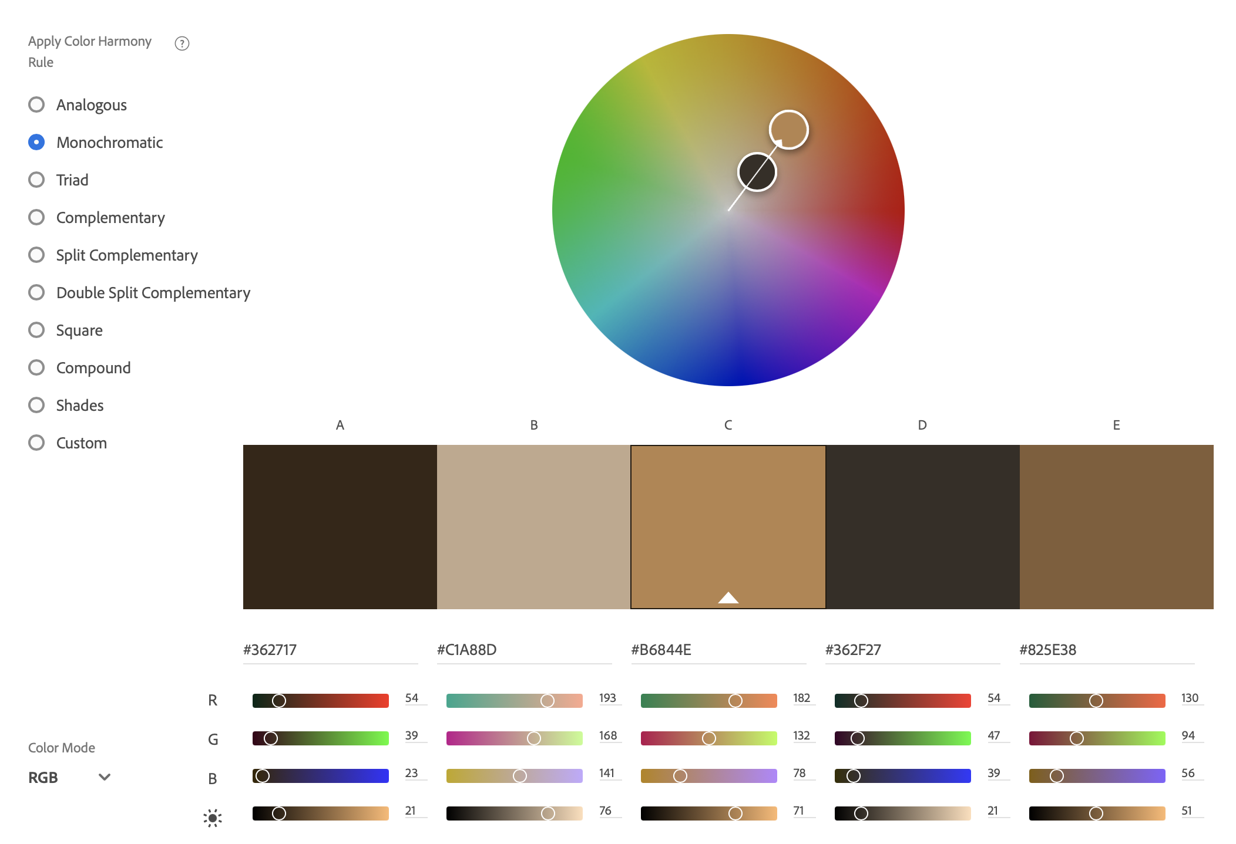
Caption
Improvement plan based on color analysis
6. Please write any suggestions to have better color harmony (2-3 sentences). When you see your photo, do you think that you have a full range of value? Do you have enough light tones (white)? Do you have enough dark tones (black)? If you can take a photo again, what can you improve it?
I think this image has a good balance of all shades, tones, and hues, of brown. The one suggestion I have would maybe to have a few more dark tones, because there are a lot more light tones in comparison.
Caption
Caption

Slide 4
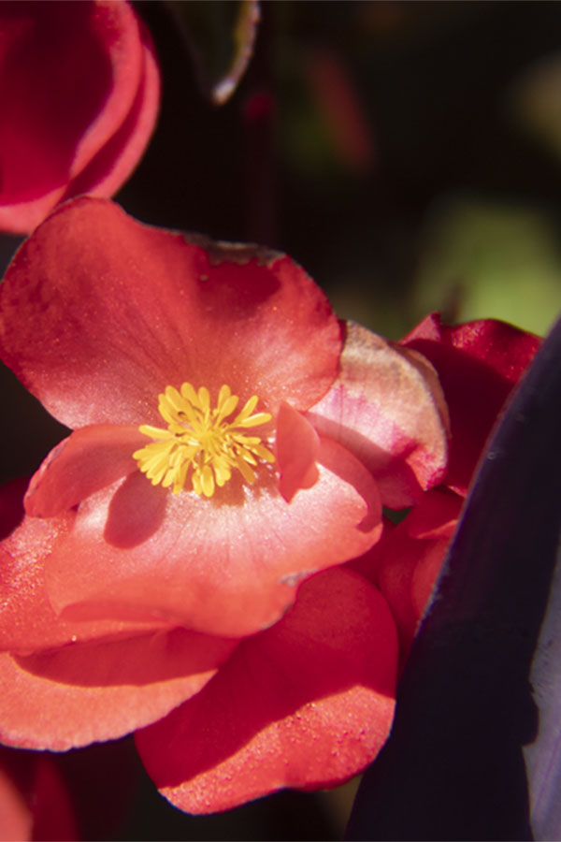
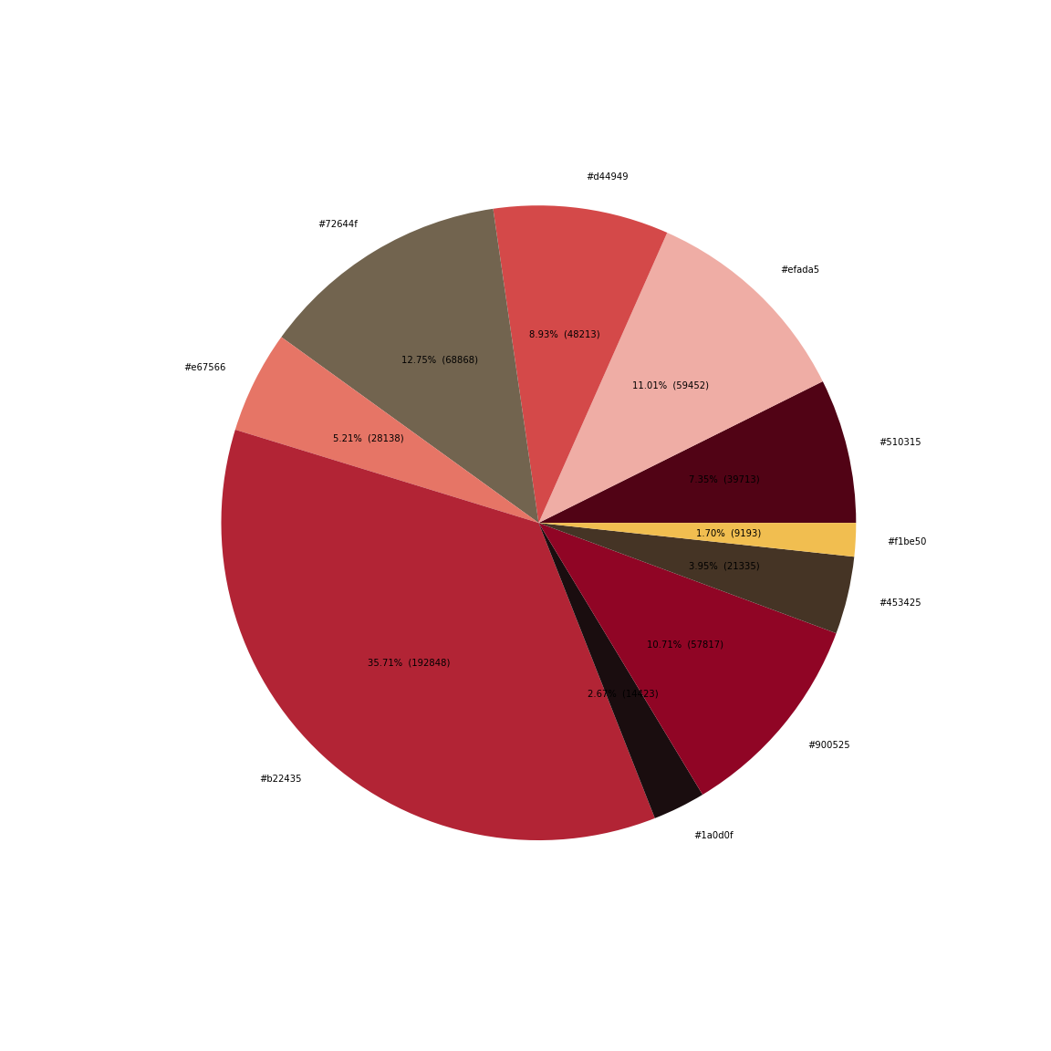
2. Analogous
Explain color harmony with color combination: Analogous color scheme with pink and yellow
Write 5 hex colors with percentages: #d44949(8.93%) #efada5(11.01%) #f1be50(1.70%) #453425(3.95%) #b22435(35.71%)
What is the color of the main subject? (color and percentage) #b22435(35.71%)
What are analogous colors (color and percentage)? #f1be50(1.70%) #efada5(11.01%) #e67566(5.21%) #d4494(8.93%) #b22435(35.71%) #900525(10.71%) #453425(3.95%)
What is the colors which are not analogous (color and percentage)? #72644f(12.75%) #510315(7.35%) #1a0d0f(2.67%)
Caption
Caption

Slide 5
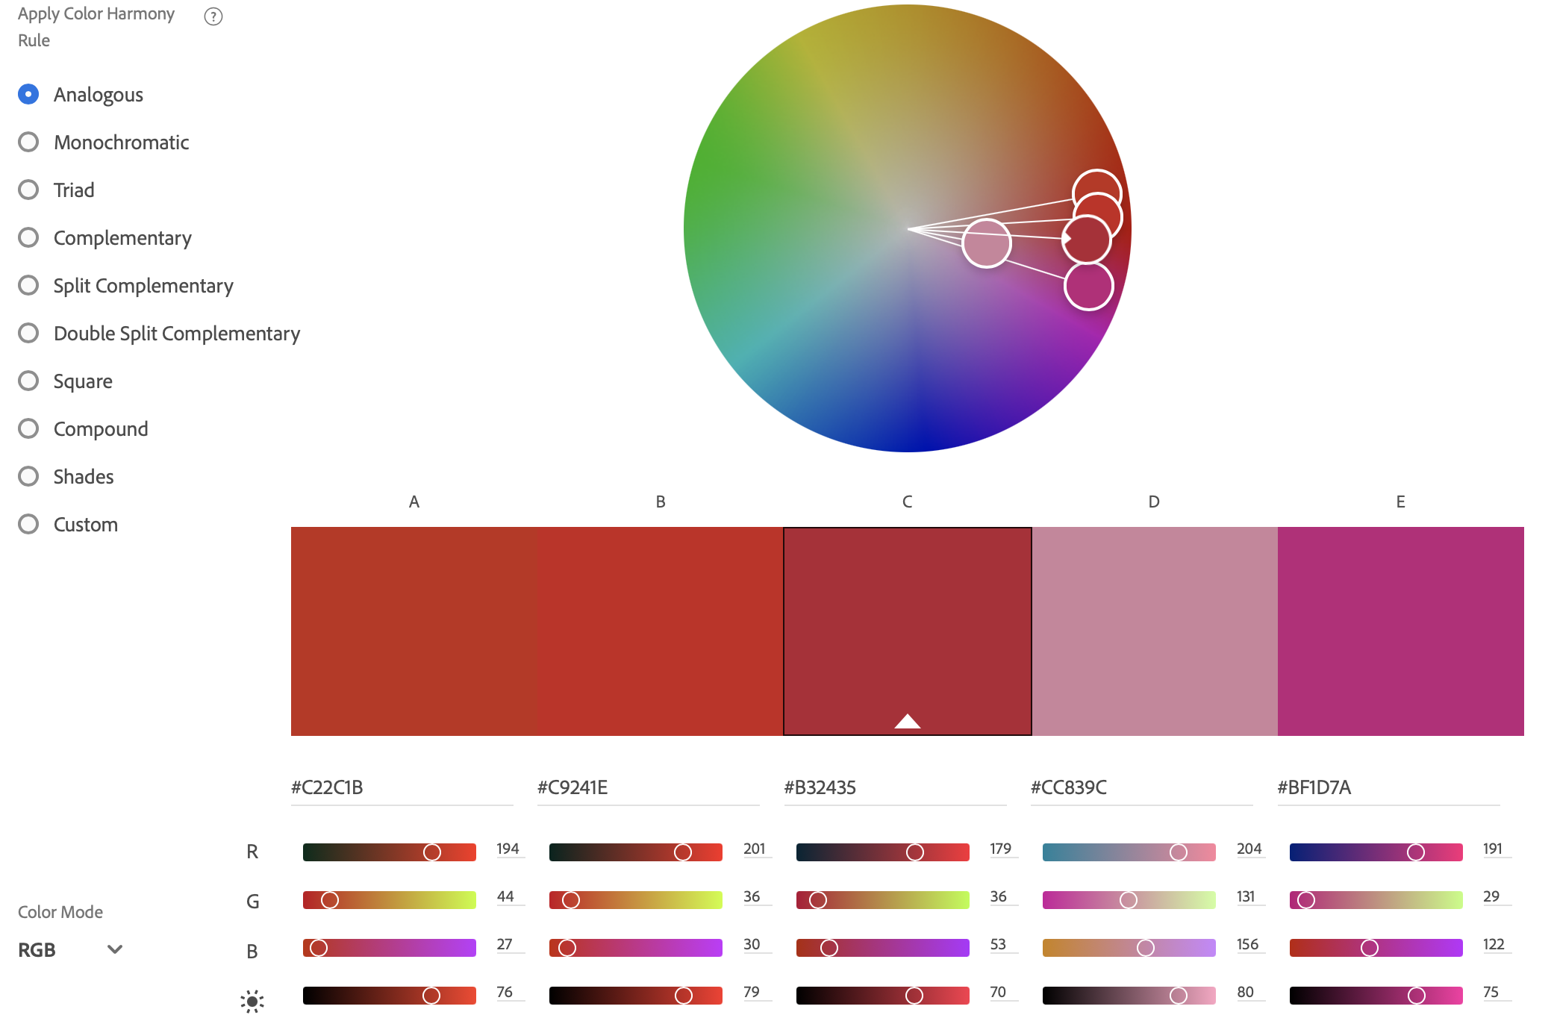
Caption
Caption
Caption
Improvement plan based on color analysis
6. Please write any suggestions to have better color harmony (2-3 sentences). When you compare your pie chart and the color wheels, which analogous colors are missing? If you can take a photo again, which color will be good to add for analogous harmony? Which color will be good to remove (background or distracting colors) for analogous harmony?
I would include more range of color, so that there would be more green and yellows. That way the pink wouldn’t’t stand out as much and there would be a better balance of color harmonies so that the image looks more analogous and less monochromatic.

Slide 6
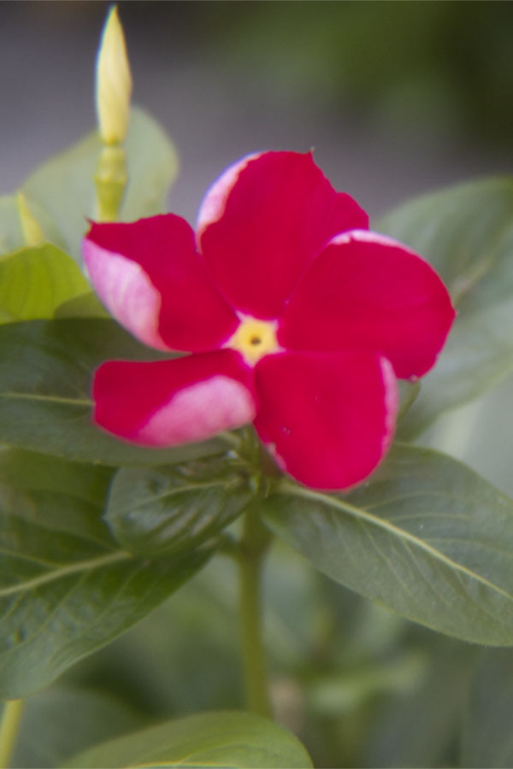
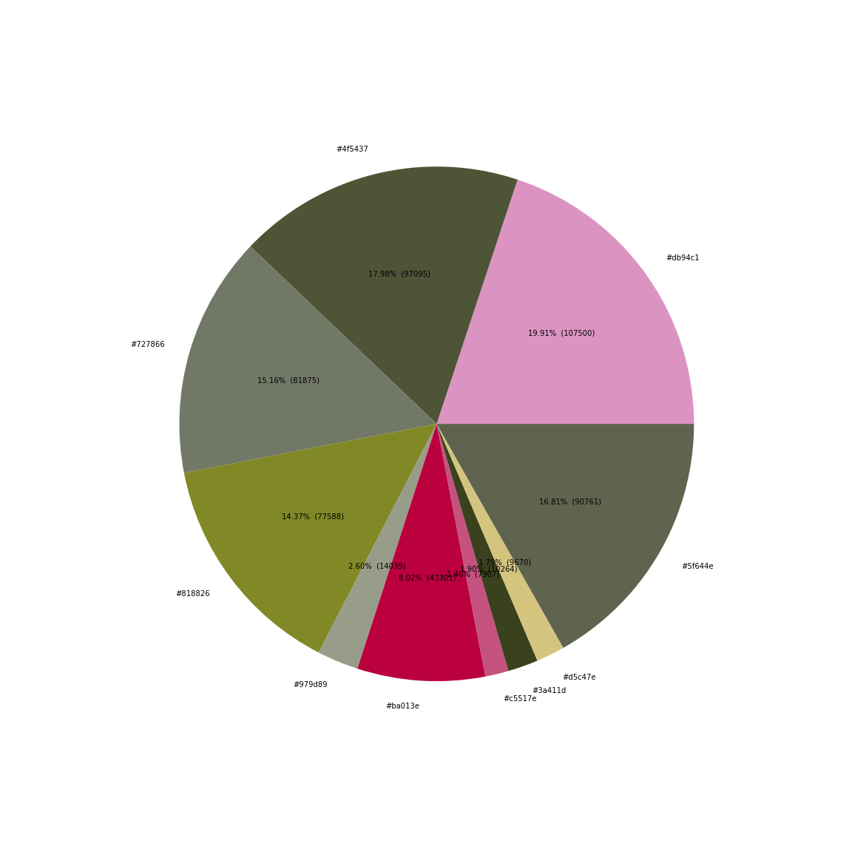
3. Complementary
Explain color harmony with color combination: complementary color scheme with reddish-pink and green
Write 5 hex colors with percentages: #ba013e(8.02%) #db94c1(19.91%) #818826(14.37%) #4f5437(17.89%) #c5517e(1.46%)
What is the color of the main subject? (color and percentage) #ba013e(8.02%) #db94c1(19.91%) #c5517e(1.46%) #3a411d(1.79%)
What are complementary colors (color and percentage)? #ba013e(8.02%) #c5517e(1.46%) #818826(14.37%) #3a411d(1.90%) #db94c1(19.91%)
What is the colors which are not complementary (color and percentage)? #d5c47e(1.79%) #979d89(2.60%) #727866(15.16%) #af5437(17.98%) #5f644e(16.81%)
Caption
Caption

Slide 7
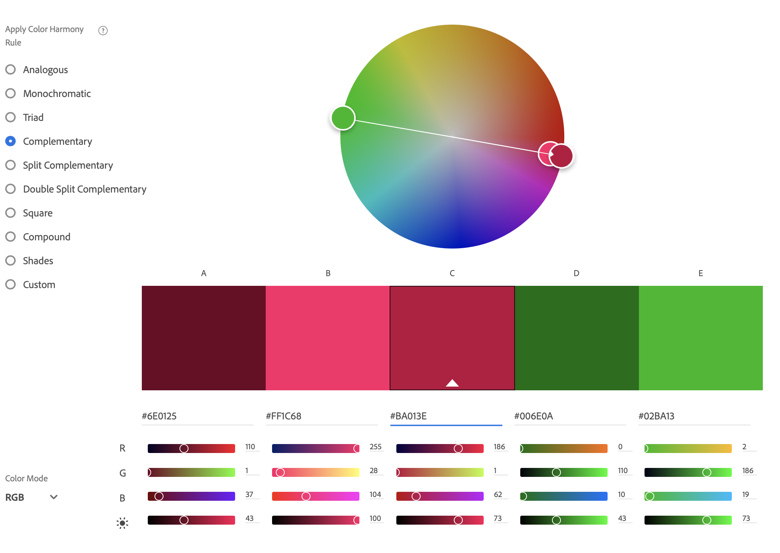
Caption
Improvement plan based on color analysis
6. Please write any suggestions to have better color harmony (2-3 sentences). What is your complementary color of the main subject? According to the color wheel, are they complementary colors (opposite colors)? (yellow-purple, orange-blue, red-green)? If not, which color combination will be better complementary? If you can take a photo again, what do you want to change?
I think this photo represents good color value, but if I could do it over, I would probably focus more on the actual flower its self. That way I would still have green in the image, but less to work with when it comes to them actually being complementary compared to the colors in the flower.
7. Please provide us with your valuable comments/suggestions for data science, color theory, color analysis project, or cross-disciplinary project.
Prior to doing this project, I had no previous knowledge of data science, especially with how it went along with digital photography and color theory. Doing this project though has shown me the importance of cross-disciplinary as it pertains to photography. This has really opened my eyes to the fact that analyzing pictures and images goes deeper than just what you see in the picture at first glance, but is truly about what you gather from breaking down the image itself and finding things you might have missed if you were just looking at the picture as a whole.
Caption
Caption

